Slide 1

CWC PROJECT
Institute of Technical Education and Research, Bhubaneswar
ADYA ABHIPSA PANDA
2041016037
CSE

Slide 2
Presentation Topic
A Java project that will convert all the forms of currency , weight , height and temperature as per user’s choice.

Slide 3
Code Description
1. Here user can convert to various forms of units of currencies , weights , heights and temperature.
2. Conversion formulas have been mentioned.
3. Switch case method have been adopted to deal with user and options ideology.
4. Repetition is continued till user enters any number other than 1.

Slide 4
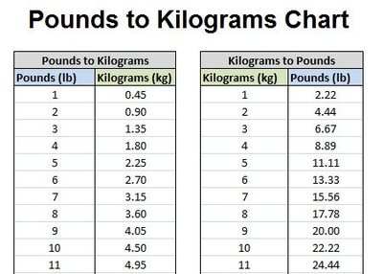
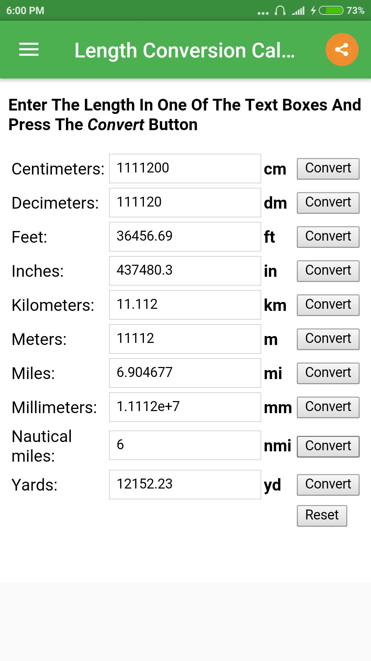
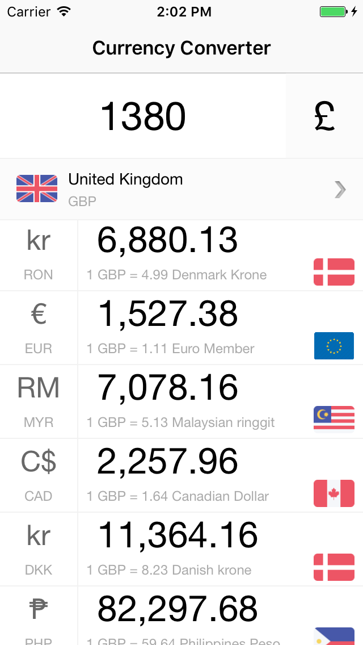
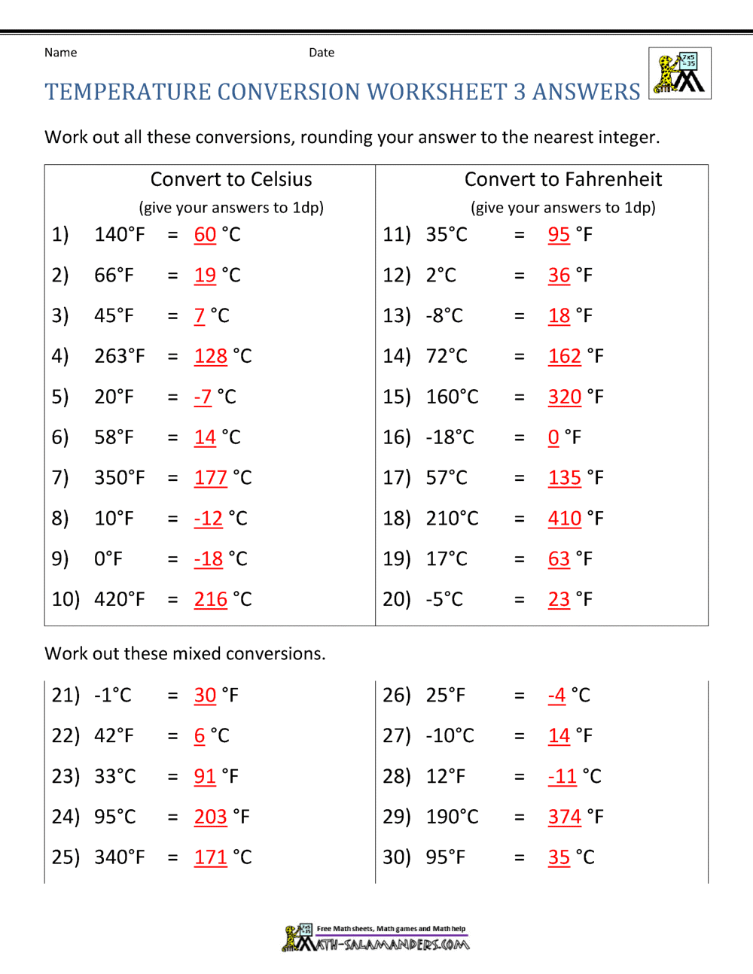
Conversion Table

Slide 5
Code Review
The main motive of the code is to preform various conversions related to currencies , temperature , height and weight.
No complex theories have been introduced in the code other than switch case , loop and arithmetic operations.
The code has been divided into 4 types and each type is further divided into 8 different types.

Slide 6
Process Of Execution
4 types of conversions are mentioned.
The user is being asked that which type of conversion he/she wants.
If user enter number > 4 then “wrong choice” message is displayed.
If number <= 4 per user’s choice the arithmetical operations are performed and expected output is displayed.
This process continues unless user enters any other number other than 1.

Slide 7
THANK YOU

